Slide 1
Rock paper scissors
Name –paras jha
Micro IT project

Slide 2
Introduction
Rock Paper Scissors is a simple yet fun hand game usually played between two people.
We’ve brought this timeless classic to the web using HTML, CSS, and JavaScript —
allowing users to play against the computer in an interactive and visually appealing interface.
Whether for fun or practice, this game offers instant entertainment right in your browser.

Slide 3
Objectives ot the game
Recreate a Classic Game in Digital Form
Bring the traditional Rock Paper Scissors game to the web for easy access and play.
Implement Game Logic Using JavaScript
Use basic conditional logic and randomization to simulate computer moves.
Enhance User Interaction and Engagement
Provide instant feedback on win/loss/draw outcomes with visual effects.
Build a Responsive and Minimal UI
Ensure a clean, mobile-friendly design using HTML and CSS.
Encourage Learning through Fun
Offer a simple project that helps beginners understand web development concepts.

Slide 4
Technical approach used in the game
.
Frontend-Only Development
Entirely built using HTML, CSS, and JavaScript without any backend.
User Interface (UI) with HTML & CSS
Structured layout with HTML elements.
Styled using CSS for a responsive, user-friendly interface.

Slide 5
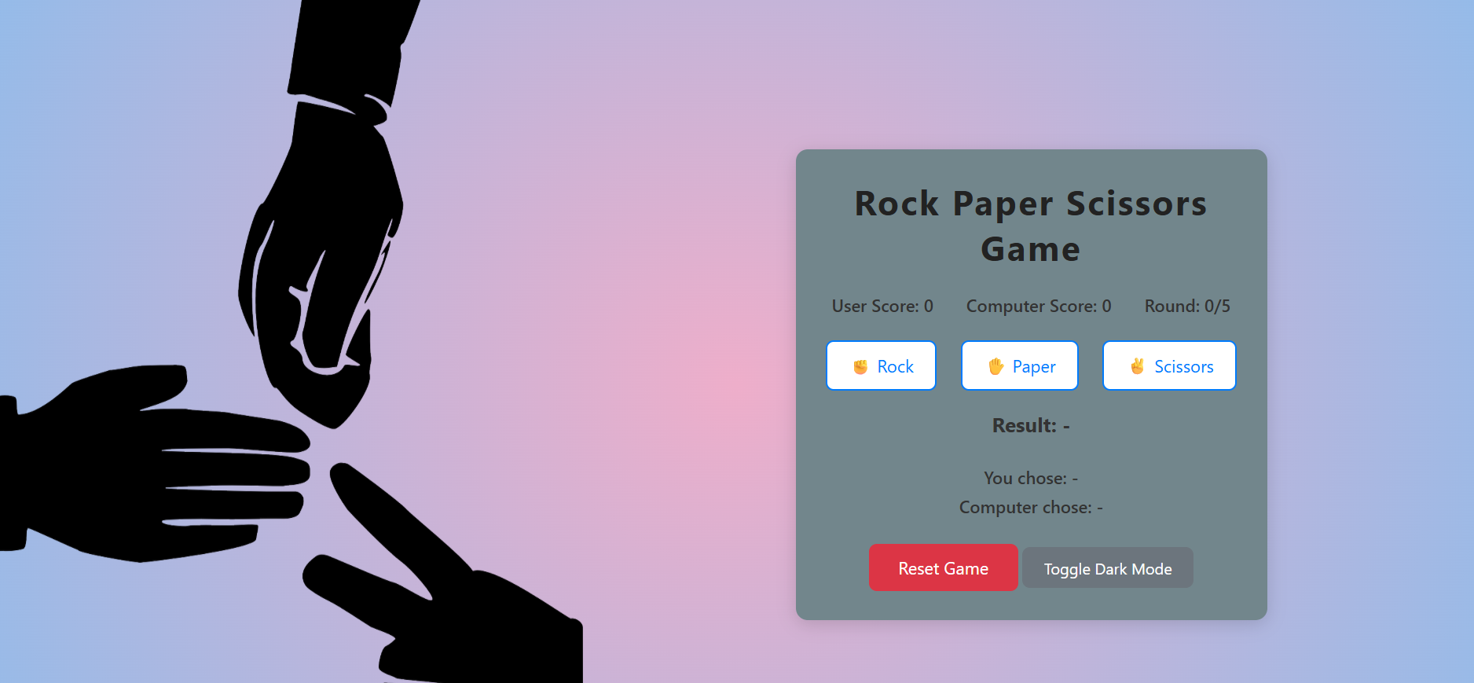
User interface of the game

Slide 6


